Slide 1
Lecture 3 : IaaS Programming Models
K. V. Subramaniam

Slide 2
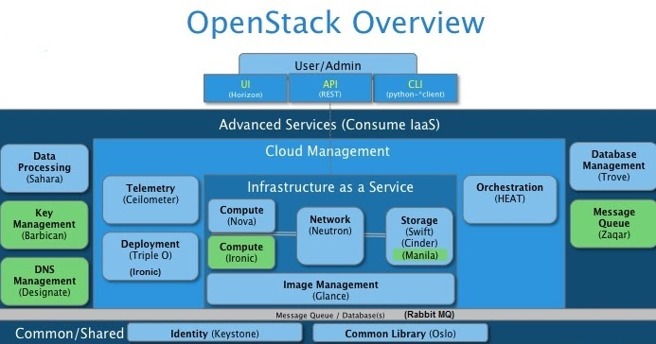
Overview
Business drivers for IaaS clouds
IaaS Programming Model
Components of an IaaS solution

Slide 3






Why do we need IaaS clouds?

Slide 4
The Old Model
Application
Each application is assigned a server
Easy of maintenance
Software and hardware are tightly coupled
Underutilised resources introduce real cost into the infrastructure
Operating System
CPU
Mem
Storage
Network

Slide 5
The New (1960s) Model
Application
Application
Physical hardware is abstracted by a virtualisation layer, or hypervisor
Manage OS and application as a single unit by encapsulating them into virtual machines
Separate OS and hardware and break hardware dependencies
Optimize utilization levels
Operating System
Operating System
CPU
Mem
Storage
Network
CPU
Mem
Storage
Network
Virtualization Layer
CPU
Mem
Storage
Network

Slide 6
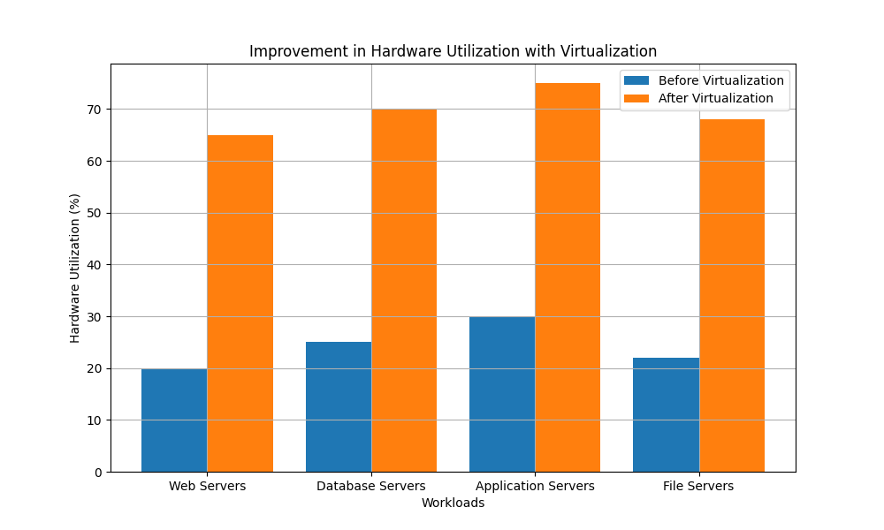
Increased Hardware Utilization
Before Virtualization
Server utilization : 10-30%
After Virtualization :
60-80% of hardware capacity
Source:
Copilot summary from multiple research papers.

Slide 7
IaaS Programming Model

Slide 8
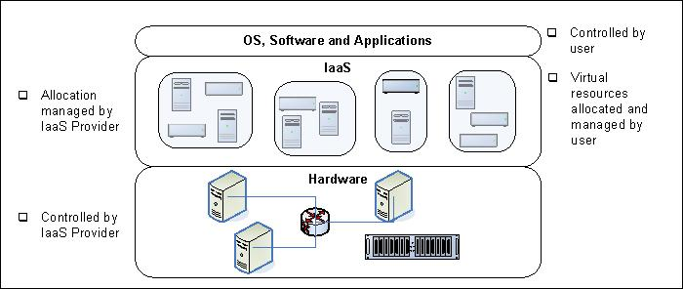
Infrastructure as a Service (IaaS)
NIST definition: The capability provided to the consumer is to provision processing, storage, networks, and other fundamental computing resources where the consumer is able to deploy and run arbitrary software, which can include operating systems and applications

Slide 9
Programming Model as you know it
You write a complex program
Helloworld.exe
Program needs resources to execute
CPU
Memory
Storage (where the program resides)
Possibly network
Access to resources made available by the OS
HelloWorld
Operating System
CPU
Mem
Storage
Network

Slide 10
Class Exercise
List down what happens below the hood of a machine when you type
./HelloWorld.exe
On the prompt?
HelloWorld
Operating System
CPU
Mem
Storage
Network

Slide 11
Motivation
You write a complex program
Helloworld.exe
Let’s assume that this program needs to run on a virtual machine
How does it get access to
CPU
Memory
Storage (where the program resides)
Possibly network
HelloWorld
Operating System
CPU
Mem
Storage
Network

Slide 12
Processing: VMs and Containers: Sharing physical machines
VMs
Each VM "looks like" an actual physical machine to the software
Can have its own OS and software
Container
Uses physical server’s OS
Actually a sandboxed process
More lightweight than a VM
VMs or containers may belong to different users
Each VM or container is isolated from other VMs
For now, don't worry about how virtualization works
We will study that in later classes
Assume it happens by magic
Achieved via the hypervisor
Physical
Server
16 cores, 32 GB
VM 2
16 core
16 GB
Container
VM 1
8 core
8 GB

Slide 13
Storage 1: Virtual Disks (aka Block Storage)
Sharing
2x256 GB
Virtual Disks
A way of sharing and pooling physical disks
Sharing: see figure
Pooling: treat disk pool as single large storage
E.g., 256 GB virtual disk using 2x128 GB from different physical disks
Can virtual disk be bigger than physical disk?
Each virtual disk can be attached to a VM
Each virtual disk "looks like" an actual physical disk to the software
Can create files on disk
Can use for paging or swapping
The virtual disks may belong to different users
Each virtual disk is isolated from other virtual disks
For now, don't worry about how disk virtualization works
VM
Physical
Disk 1TB
1x512 GB Virtual Disk
Disk pool: collection of disks

Slide 14
Storage 2: Object Store (aka Blob Store)
Extremely Large Blob Store
(media, OS binaries, application binaries)
Similar to Dropbox/Google Drive/Amazon S3
Stores files
Retrieved by application for usage
Referenced by URL
Typically <account>/<container>/<object name>
E.g., http://myaccount.blob.core.windows.net/container/object in Azure
Media server
Media server
Media server
Media server

Slide 15
Virtual Networking 1
Physical Server
VM 1
VM 2
Like physical network, contains virtual adapters and virtual switches
Each VM has one or more virtual network adapters (V)
These have IP addresses, DNS names, just like a physical adapter
This is completely in software
VS is a virtual network switch
Completely in software
VP is a virtual port
Network adapter, invisible to network
No IP address, only MAC address
N is the network adapter of the physical server
V
V
VS
VP
VP
VP
VP
N
N

Slide 16
Virtual Networking 1: Q&A
Physical Server
VM 1
VM 2
Note
VMs generally can see only IP addresses of other VMs
The cannot see IP addresses of the physical adapters N (generally)
How does VM 1 send a message to VM 2?
V
V
VS
VP
VP
VP
VP
N
N

Slide 17
Virtual Networking 1: Q&A
Physical Server
VM 1
VM 2
Note
VMs generally can see only IP addresses of other VMs
The cannot see IP addresses of the physical adapters N (generally)
How does VM 1 send a message to VM 2?
Specify destination IP address of VM 2
V->VP->VP->V
V
V
VS
VP
VP
VP
VP
N
N

Slide 18
Virtual Networking 1: Exercise (5 mins)
Physical Server
Note
VMs generally can see only IP addresses of other VMs
The cannot see IP addresses of the physical adapters N (generally)
How does VM 2 send a message to the outside world (outside server)?
VM 1
VM 2
V
V
VS
VP
VP
VP
VP
N
N

Slide 19
Virtual Networking 1: Solution
Physical Server
Note
VMs generally can see only IP addresses of other VMs
The cannot see IP addresses of the physical adapters N (generally)
How does VM 2 send a message to the outside world (outside server)?
Specify IP address of VM in outside world
V->VP->VP->N->outside world
VM 1
VM 2
V
V
VS
VP
VP
VP
VP
N
N

Slide 20
Creation of a VM
Blob Store
(OS binaries, application binaries)
User specifies
VM configuration (e.g., memory)
Software
Cloud software
Create actual VM
Create virtual disk(s) needed
Copy OS and app binaries to boot disk
Boot OS
Set up virtual network
VM
V
Network

Slide 21
Class Exercise (10 mins)
Suppose we wanted to implement a bookstore portal called Bookarts
Consider
User searches for book
User orders book
How would the Bookarts example be implemented in an IaaS cloud?
Points to ponder
Who creates the VM?
Which machine is the VM created on?
Hints
What VMs do we need?
Storage: what virtual disks are attached to the VMs? What do they contain?
What software needs to be on the VMs?
Networking: how are the VMs interconnected? What is the connection to the outside world?

Slide 22

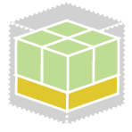

But questions arise as the environment grows...
“VM sprawl” can make things unmanageable very quickly
APPS
USERS
ADMINS
How do you make your apps cloud aware?
How do you empower employees to self-service?
Where should you provision new VMs?
How do you keep track of it all?
+
A Cloud Management Layer Is Missing
Server Virtualization
2. Cloud Data Center
3. Cloud Federation
1. Virtualization

Slide 23
IaaS Architecture
Cloud Controller Responsibilities
- Schedule and manage VM
- Security
- Fault handling
IaaS Cloud Controller
Physical infrastructure

Slide 24
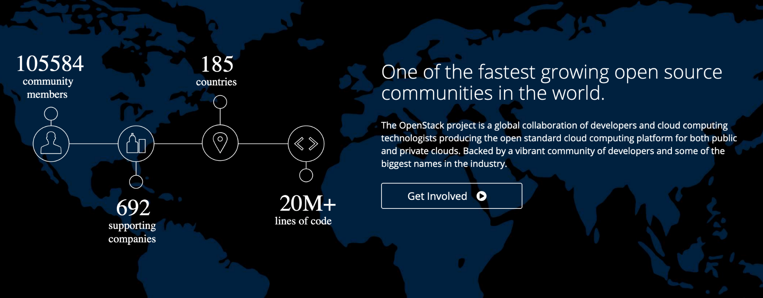
Fastest Growing Global Open Source Community
https://www.openstack.org/
Notes:
More than 10k members! You should join!
Of the total contributors, 800-900 are still active, which shows that people stick around.
Even had downloads from Antarctica!

Slide 25
Openstack Design Principles
Built as a collection of independent services
Services provide REST APIs

Slide 26
SOA Elements
Service Registry
Communicate with messages
No knowledge about partner
Likely heterogeneous
Build applications by making service calls
Simple if interface is REST!
Look up list of Services and Endpoint (IP address, port)
Service Consumers
Service Producers

